Slide 1
MENTORNESS TASK ONE
Hotel Reservation Analysis with SQL
By
Olabisi Olaleye

Slide 2
CONTENT
Introduction
Project Objective
Dataset Overview
Key Questions For Analysis
Data Exploration and Analysis(Including query codes)
Summary

Slide 3
INTRODUCTION
The Hotel Reservation Analysis Project is my first task for my internship with Mentorness. In this project I utilized SQL to query and analyze the hotel reservation dataset, to gain insights into key factors that impact the hotel's operations.
PROJECT OBJECTIVE
The hotel industry relies on data to make informed decisions and provide a better guest experience. Using a hotel reservation dataset, this project is aimed at gaining insights into guest preferences, booking trends, and other key factors that impact the hotel's operations. MYSQL Workbench was used in running the query and analysis of the data, as well as to answer specific questions about the dataset.

Slide 4
DATASET OVERVIEW
The dataset includes the following columns:
Booking_ID: A unique identifier for each hotel reservation.
no_of_adults: The number of adults in the reservation.
no_of_children: The number of children in the reservation.
no_of_weekend_nights: The number of nights in the reservation that fall on weekends.
no_of_week_nights: The number of nights in the reservation that fall on weekdays.
type_of_meal_plan: The meal plan chosen by the guests.
room_type_reserved: The type of room reserved by the guests.
lead_time: The number of days between booking and arrival.
arrival_date: The date of arrival.
market_segment_type: The market segment to which the reservation belongs.
avg_price_per_room: The average price per room in the reservation.
booking_status: The status of the booking

Slide 5
KEY QUESTIONS FOR ANALYSIS
What is the total number of reservations in the dataset?
Which meal plan is the most popular among guests?
What is the average price per room for reservations involving children?
How many reservations were made for the year 2018?
What is the most commonly booked room type?
How many reservations fall on a weekend (no_of_weekend_nights > 0)?
What is the highest and lowest lead time for reservations?
What is the most common market segment type for reservations?
How many reservations have a booking status of "Confirmed"?
What is the total number of adults and children across all reservations?
What is the average number of weekend nights for reservations involving children?
How many reservations were made in each month of the year?
What is the average number of nights (both weekend and weekday) spent by guests for each room type?
For reservations involving children, what is the most common room type, and what is the average price for that room type?
Find the market segment type that generates the highest average price per room.

Slide 6

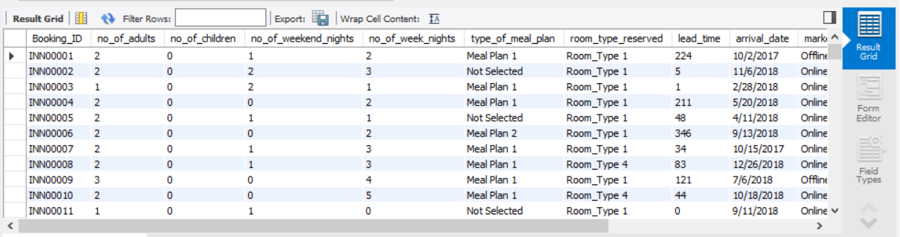
DATA EXPLORATION AND ANALYSIS
Import hotel reservation dataset into MYSQL workbench as hotelreservation_table
Select all from hotel reservation table to view dataset using the “SELECT*” function.

Slide 7

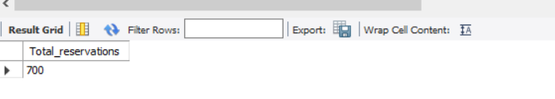
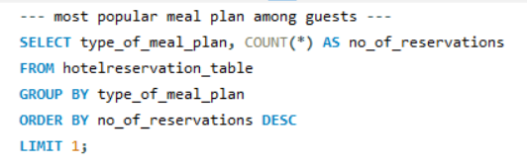

1. Total number of reservation in the dataset
2. Most popular meal plan among guests

Slide 8
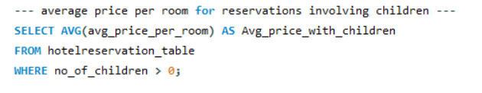

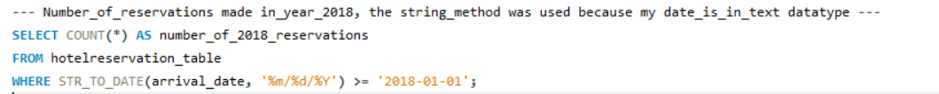

3. Average price per room for reservations involving children
4. Number of reservations were made for the year 2018? (The string method was used because my date is in text datatype)

Slide 9
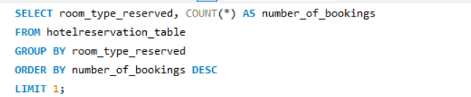

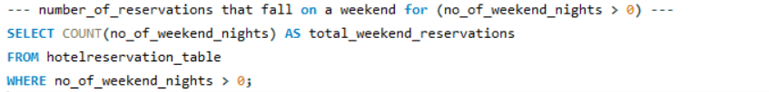
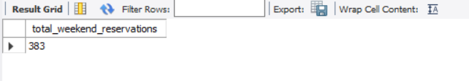
5. Most commonly booked room
6. Number_of_reservations that fall on a weekend for (no_of_weekend_nights > 0)

Slide 10

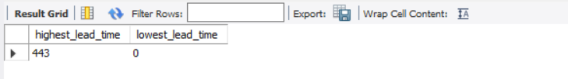
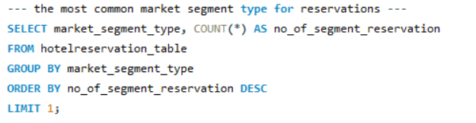
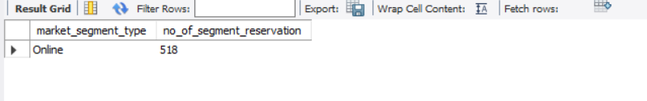
7. Highest and lowest lead_time for reservations
8. The most common market segment type for reservations

Slide 11
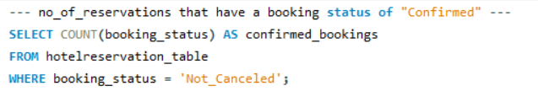
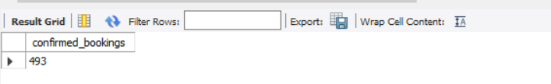

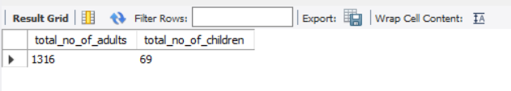
9. Number of reservations that have a booking status of "Confirmed“
10. Total number of adults and children across all reservations

Slide 12
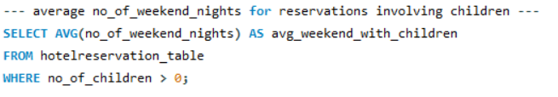
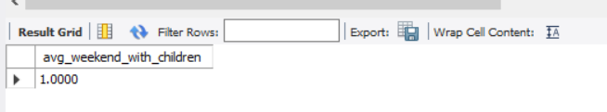
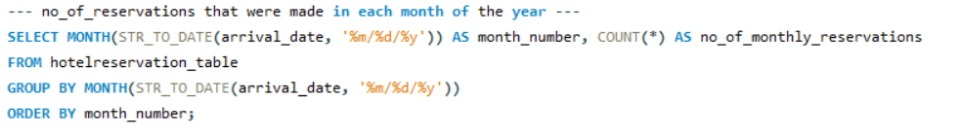
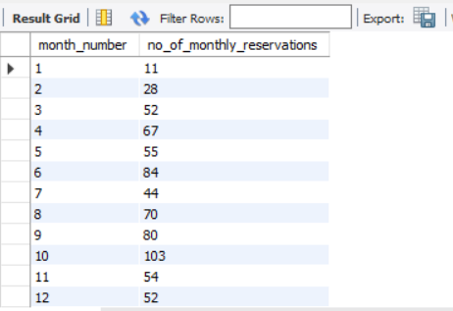
11. Average number of weekend nights for reservations involving children
12. Number of reservations that were made in each month of the year

Slide 13
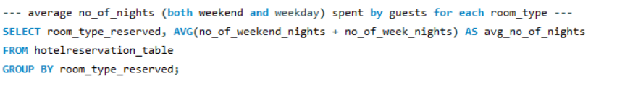
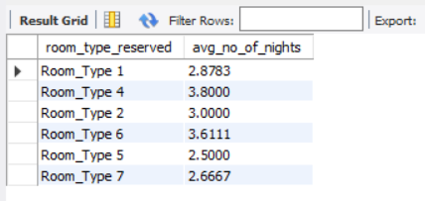
13. Average number of nights (both weekend and weekday) spent by guests for each room type

Slide 14
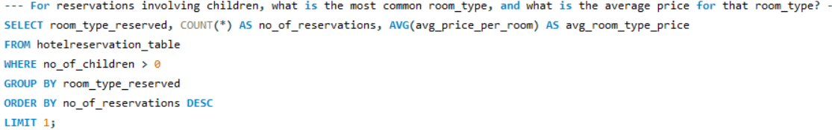
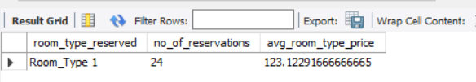
14. For reservations involving children, what is the most common room type, and what is the average price for that room type?

Slide 15
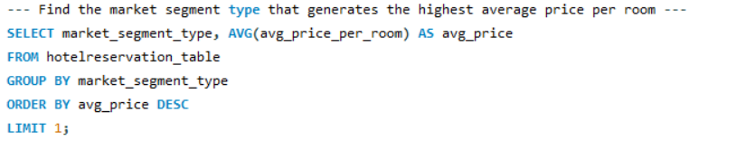
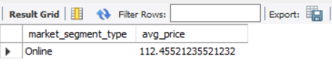
15. Find the market segment type that generates the highest average price per room

Slide 16
CONCLUSION
Leveraging the insights gotten from this analysis, the hotel can implement the following recommendations:
Optimize room pricing strategies: From the analysis, the most commonly booked room type, and average prices for these rooms were deduced. The hotel can leverage this to tailor room rates to maximize revenue.
Develop targeted marketing campaigns: Insights were gotten into guest preferences like the popular meal plans, and market segment trends that generate the highest average price per room. This allows for focused marketing efforts to attract desired guests.
Improve resource allocation: The insights gotten from the booking trends for weekends and specific months will help the hotel with an efficient staff scheduling and resource allocation.
Enhance guest experience: Insights gotten from the lead time variations and reservation preferences for guests with children can be used for better service planning and catering to specific needs.

